Slide 1
Lebanese RESTAURANT IN SYDNEY

Slide 2
Why choosing a Lebanese Restaurant in Sydney?
Ancient cuisine and part of the Levant
Influenced by different foreign civilizations
Loved by people from different cultures
Sydney has a lot of Lebanese people residing in it

Slide 3
Data Acquisition
Defining a center point in a crowded area
Creating a circular grid of radius 300m over an area of 12kmx12km
Using Google Maps API reverse Geocoding to get the addresses
Using Fouresquare API to get number of restaurants in each area

Slide 4
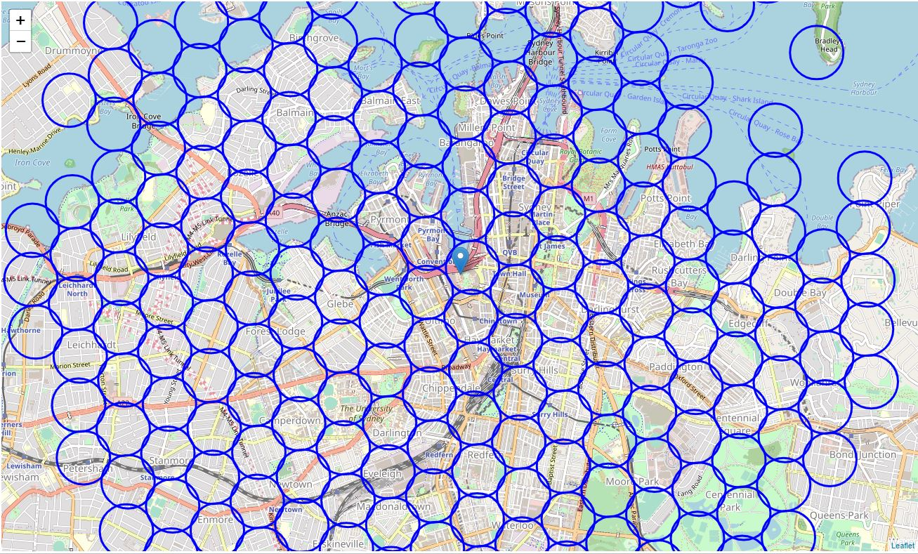
The resulting Map with Darling Harbor in the middle

Slide 5
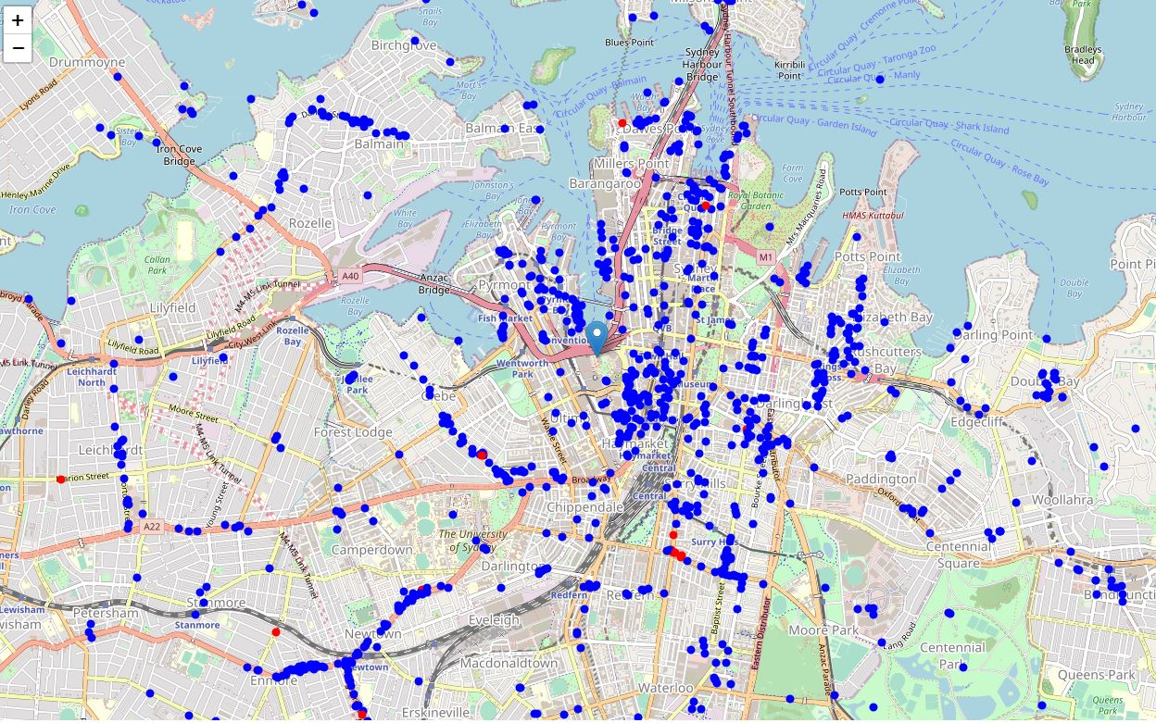
- Blue dots representing Restaurants
- Red dots representing Lebanese Restaurants

Slide 6
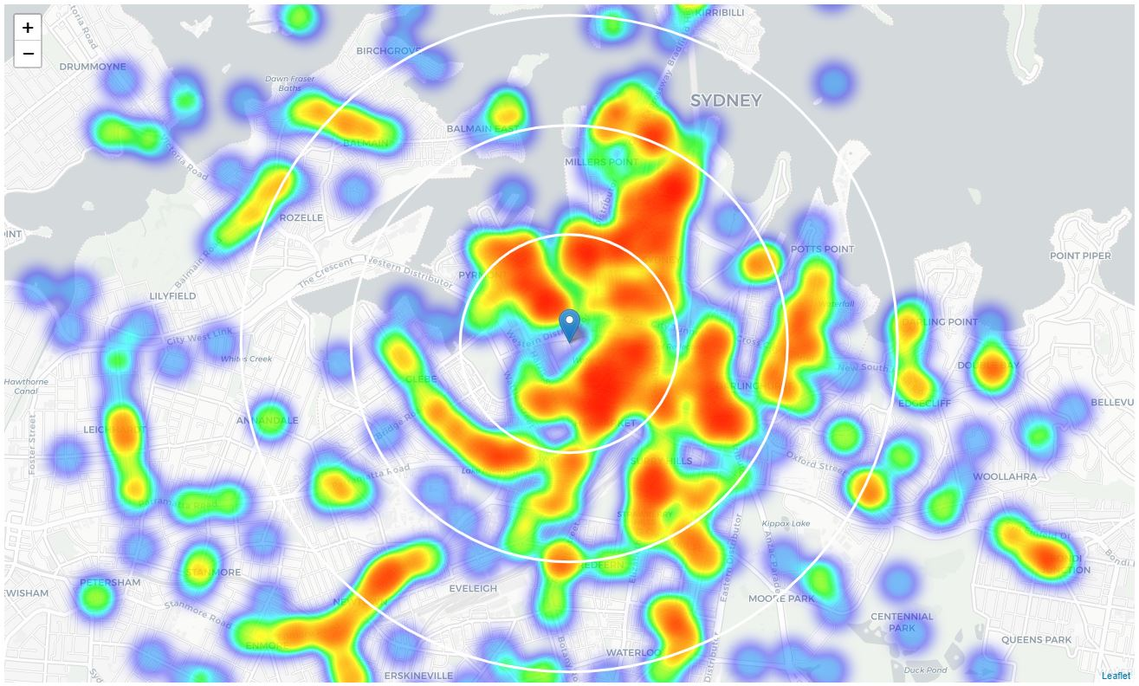
This Heatmap shows density of restaurants within 1km, 2km and 3km distance from Darling Harbor

Slide 7
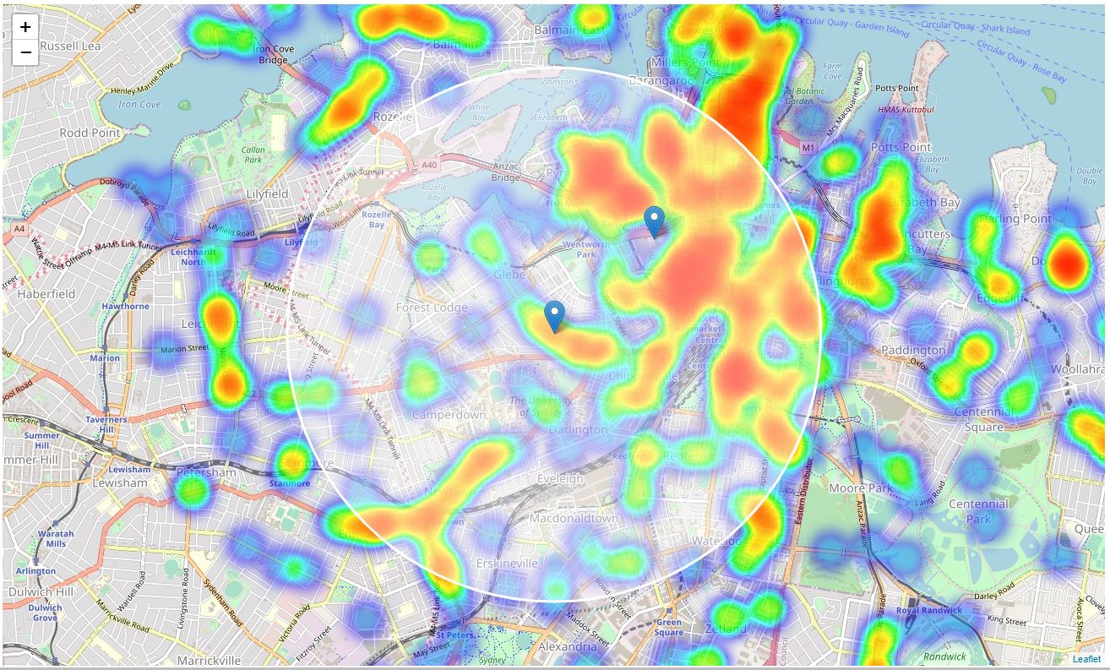
Area of interest is now shifted South West, as it has bigger Lebanese community and lower restaurant density

Slide 8
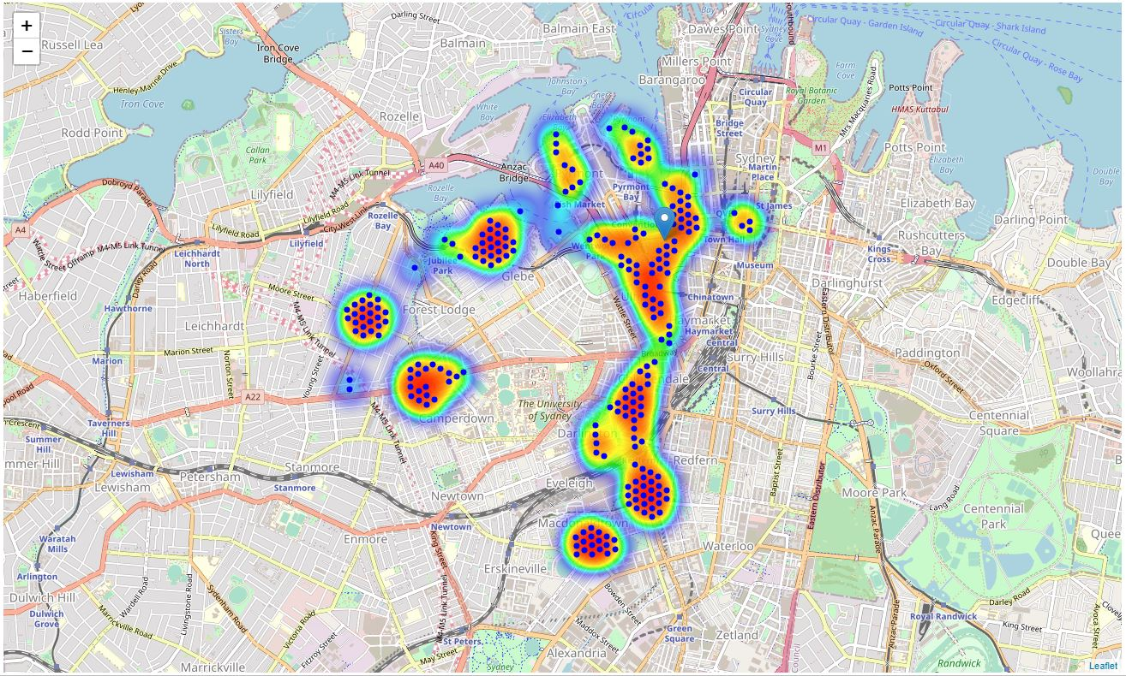
Potential candidates for a new Lebanese restaurant

Slide 9
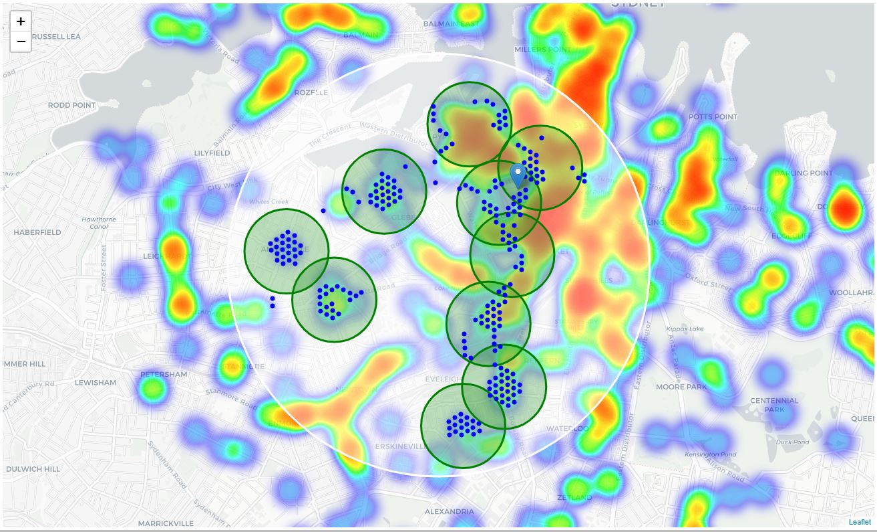
Locations clustered to create 10 zones containing best locations.

Slide 10
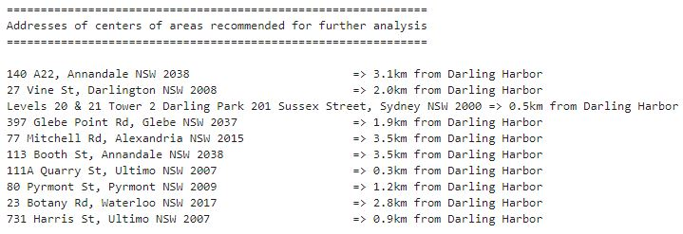
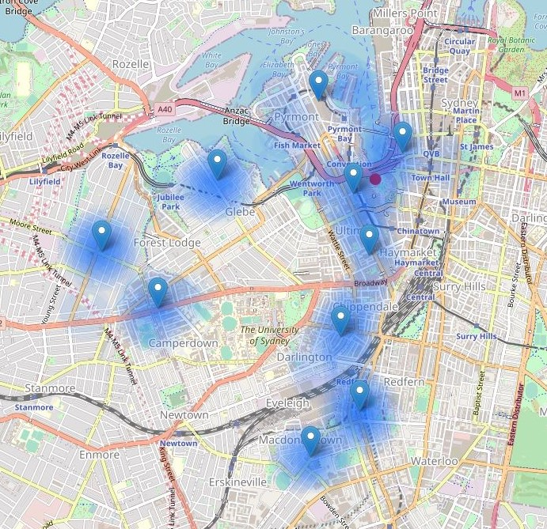
10 potential addresses chosen:
With low number of restaurants nearby
With no Lebanese restaurants within 1 KM distance
Fairly close to city center

Slide 11
Thank you

